Slide 1
Employee Attrition Prediction System
Leveraging Machine Learning for Data-Driven HR Retention
Team Members
Ayana Santhosh Khan
Hemalekshmi R
Athulya Mannambath

Slide 2
Problem Statement
Employee turnover creates major organizational challenges. Traditional HR strategies are reactive rather than proactive. The goal is to build a predictive machine learning system that identifies employees at high risk of attrition before resignation
Recruitment Costs
High expenses associated with sourcing, interviewing, and onboarding new hires.
Training Expenses
Significant investment required to bring new employees up to full productivity.
Productivity Loss
Team output and morale decline during transition periods and understaffing.
Workforce Instability
Frequent departures disrupt operations, culture, and long-term planning.
Key Transition: Moving from Reactive HR — responding after employees resign — to Predictive HR Analytics — identifying at-risk employees before they leave.

Slide 3
Dataset Overview — IBM HR Analytics
Dataset Statistics
Source: IBM HR Analytics Attrition Dataset (Kaggle)
Total Employee Records : 1,470
HR-Related Features : 35
Target: Attrition (0=No,1 = Yes)
Challenge : Moderately imbalanced dataset (84% Retention vs 16% Attrition)
Key Influential Features
Overtime
Monthly Income
Job Level
Years at Company
Job Satisfaction
Work-Life Balance

Slide 4
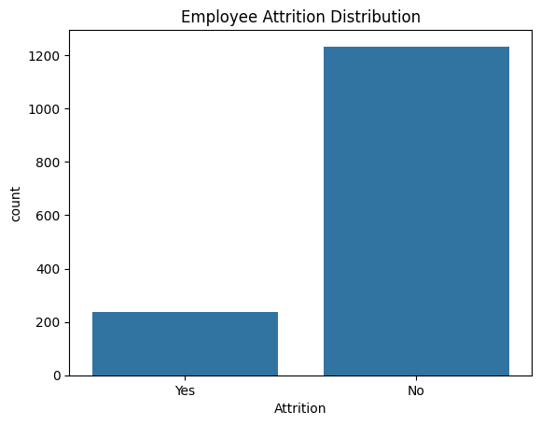
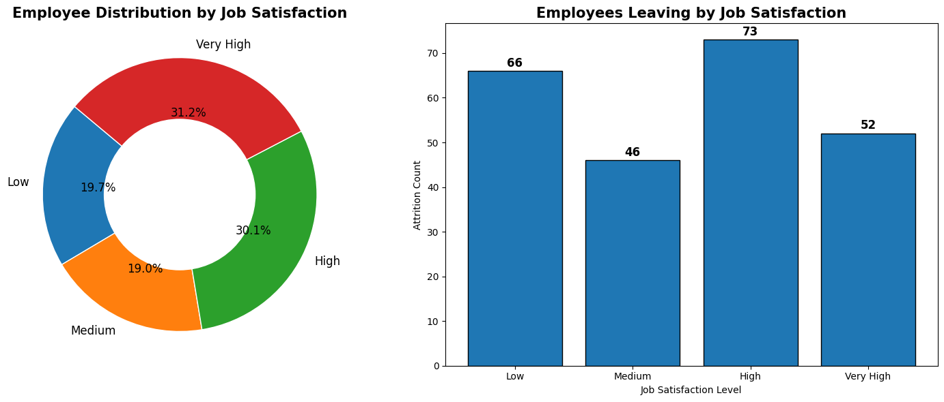

Slide 5
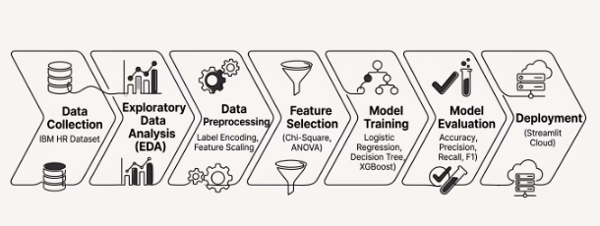
Methodology & Machine Learning Pipeline
The complete project lifecycle follows a structured ML workflow — from raw HR data collection through exploratory analysis, preprocessing, model training, evaluation, and final deployment via Streamlit. Technologies used include Python, Pandas, Scikit-learn, XGBoost, and Streamlit.
Each stage builds on the previous, ensuring data quality, model reliability, and a production-ready deployment that HR teams can use in real time.

Slide 6
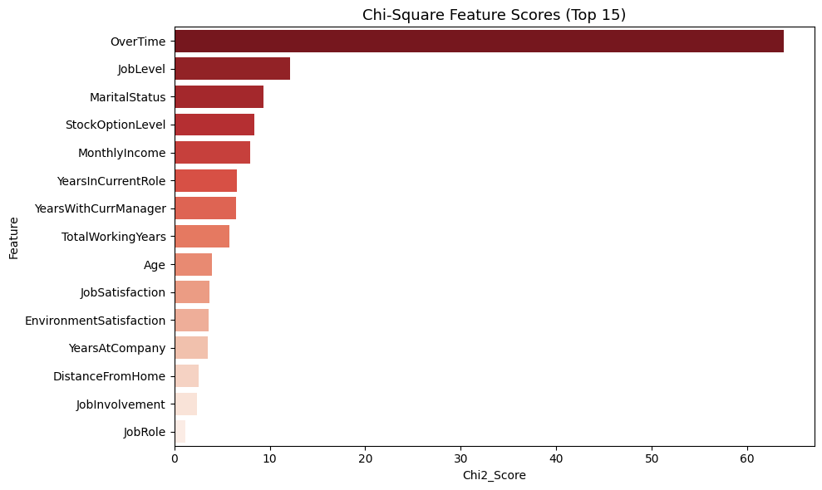
Feature Engineering & Statistical Selection
Statistical feature selection techniques were used to identify the most important predictors of employee attrition. The goal was to reduce dimensionality while retaining the most informative HR attributes for model training.
Chi-Square Test
Used for categorical features to measure dependency between variables and attrition.

Slide 7
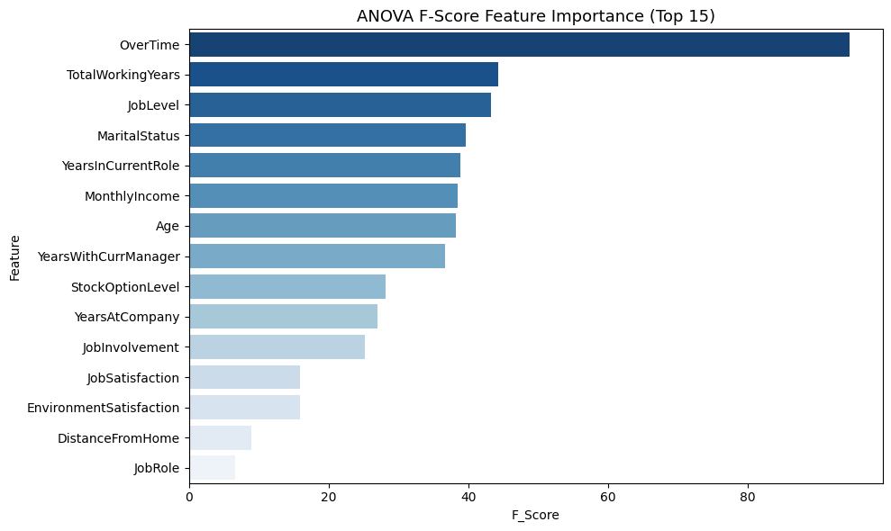
ANOVA F-Test
Applied to numerical features to assess variance contribution to the target class.
Top 15 Features
Selected the most relevant HR features to optimize model performance and interpretability

Slide 8
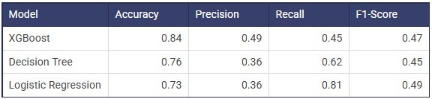
Model Performance & Comparison
Three models were trained and evaluated on the IBM HR dataset. XGBoost achieved the best overall performance with approximately 84% accuracy. Due to class imbalance (84% retention, 16% attrition), Recall and F1-Score were prioritized to minimize false negatives — missing an employee who will leave is far costlier than a false alarm

Slide 9
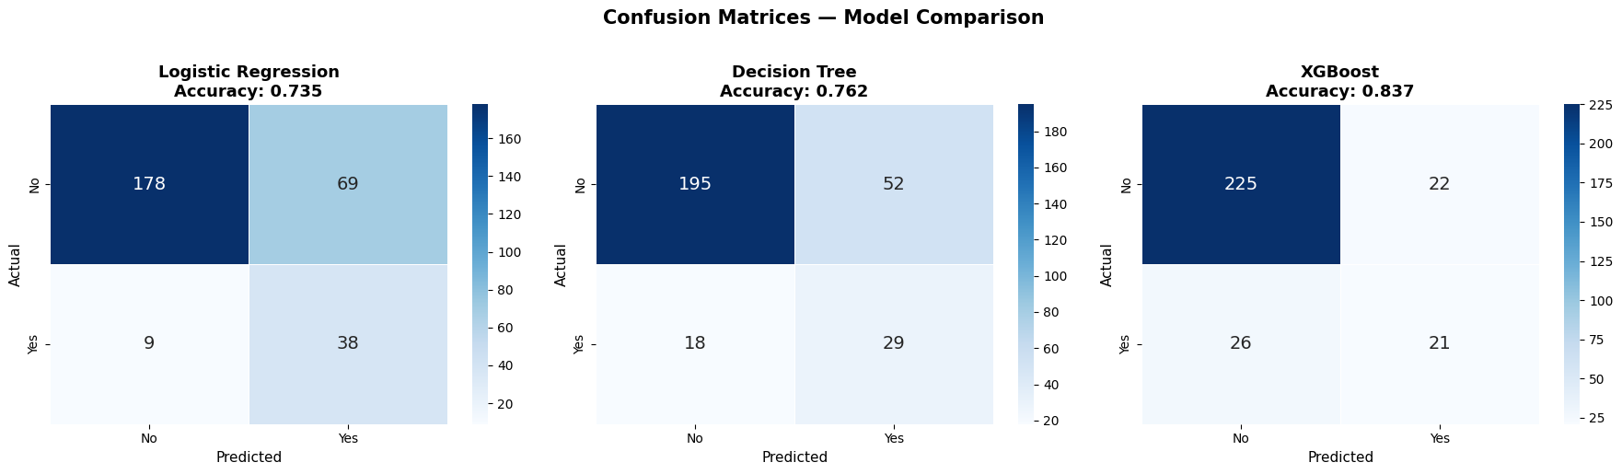

Slide 10
Explainable AI — SHAP Values
What is SHAP?
SHAP (SHapley Additive exPlanations) was used for model interpretability. The system doesn't just predict — it explains why an employee is at risk of leaving, making the model transparent and actionable for HR decision-makers.
SHAP Feature Contribution
Higher SHAP values indicate stronger influence on the model's attrition prediction for each feature.
Overtime
Highest attrition risk factor — employees working overtime are significantly more likely to resign.
Low Monthly Income
Below-market compensation is a strong predictor of employee departure.
Lower Job Level
Junior-level employees show higher attrition rates, often due to career growth concerns.
Poor Work-Life Balance
Employees reporting poor balance are at elevated risk of voluntary turnover.

Slide 11
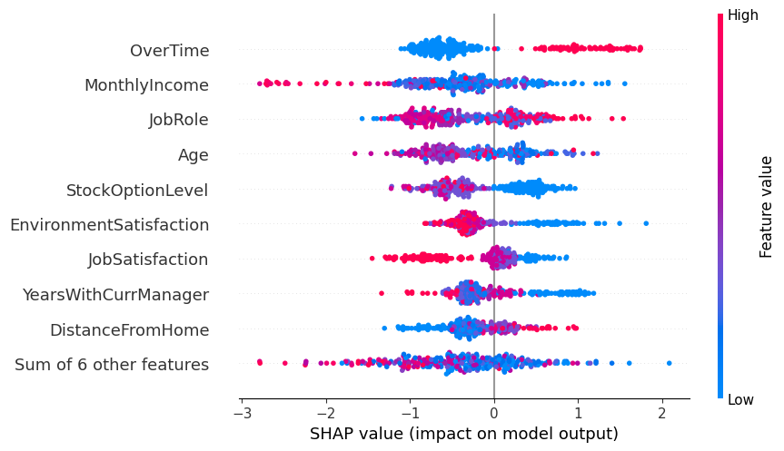
SHAP Summary Plot: Key Factors Influencing Employee Attrition

Slide 12
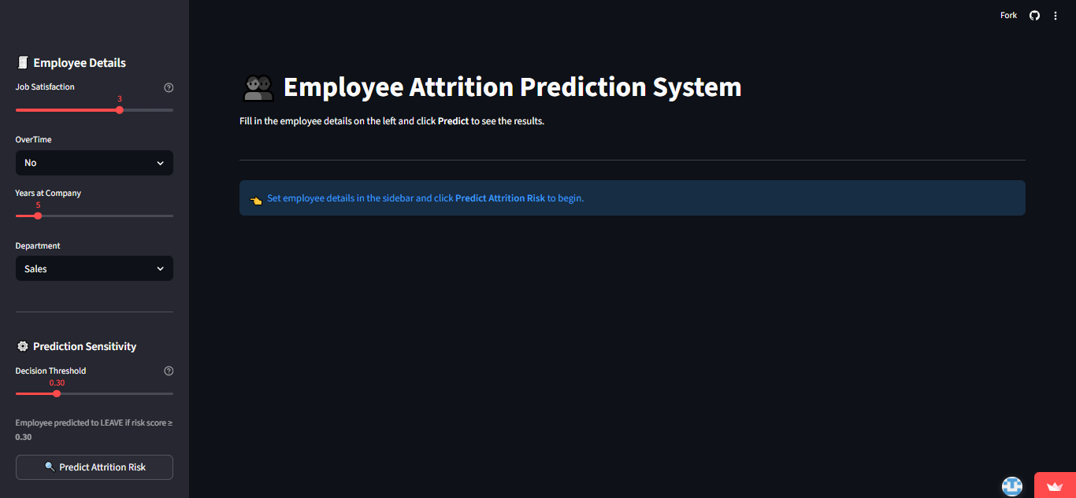
Real-Time Employee Attrition Prediction Dashboard
The trained XGBoost model was deployed using Streamlit Cloud, enabling HR professionals and managers to input employee details and instantly receive attrition risk predictions with probability-based assess

Slide 13
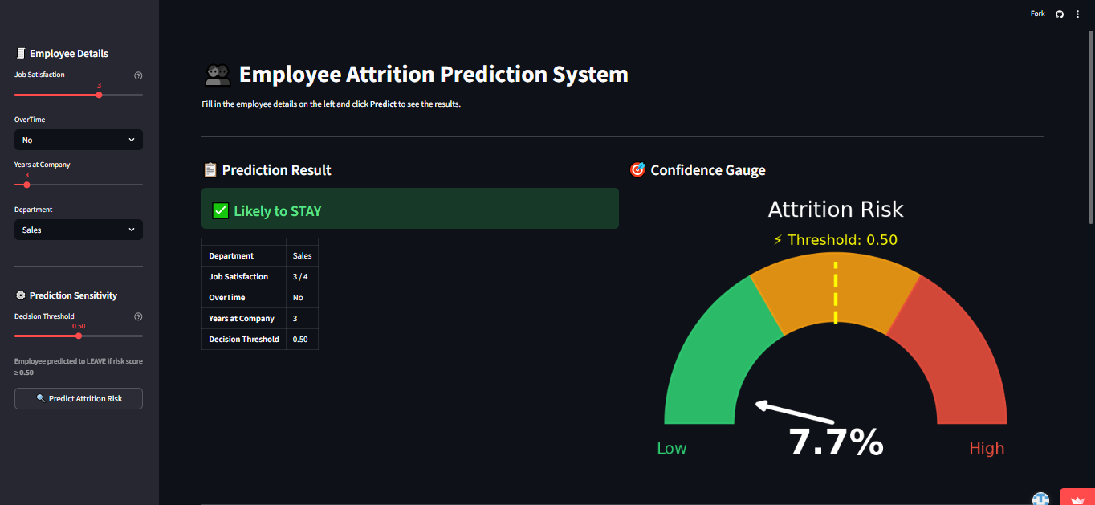
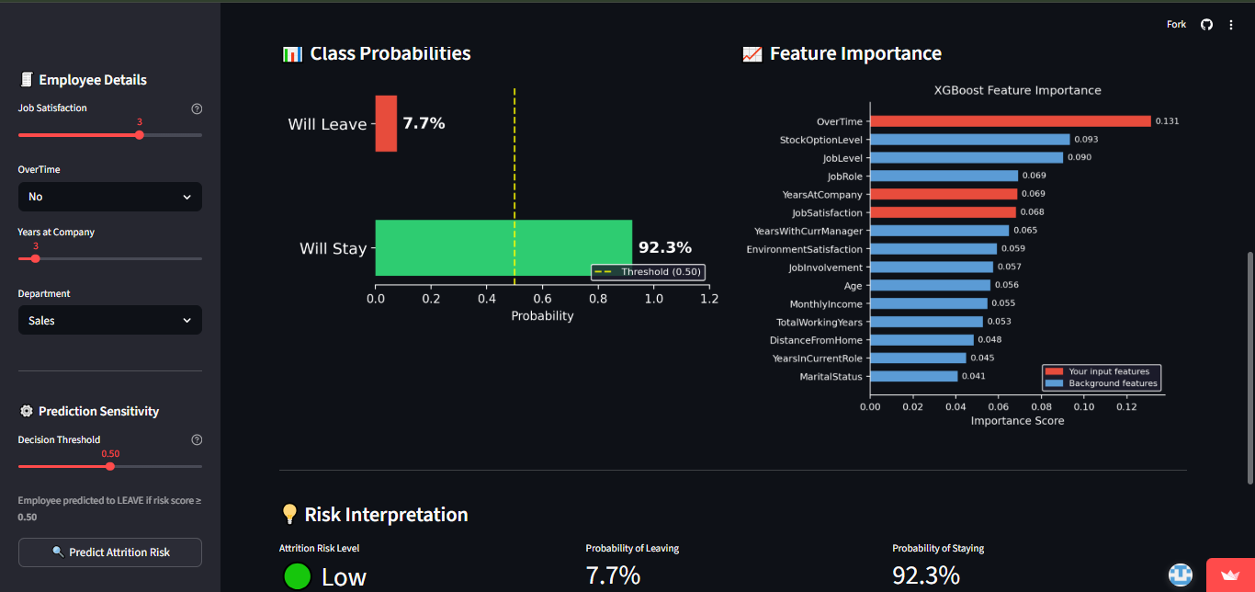

Slide 14
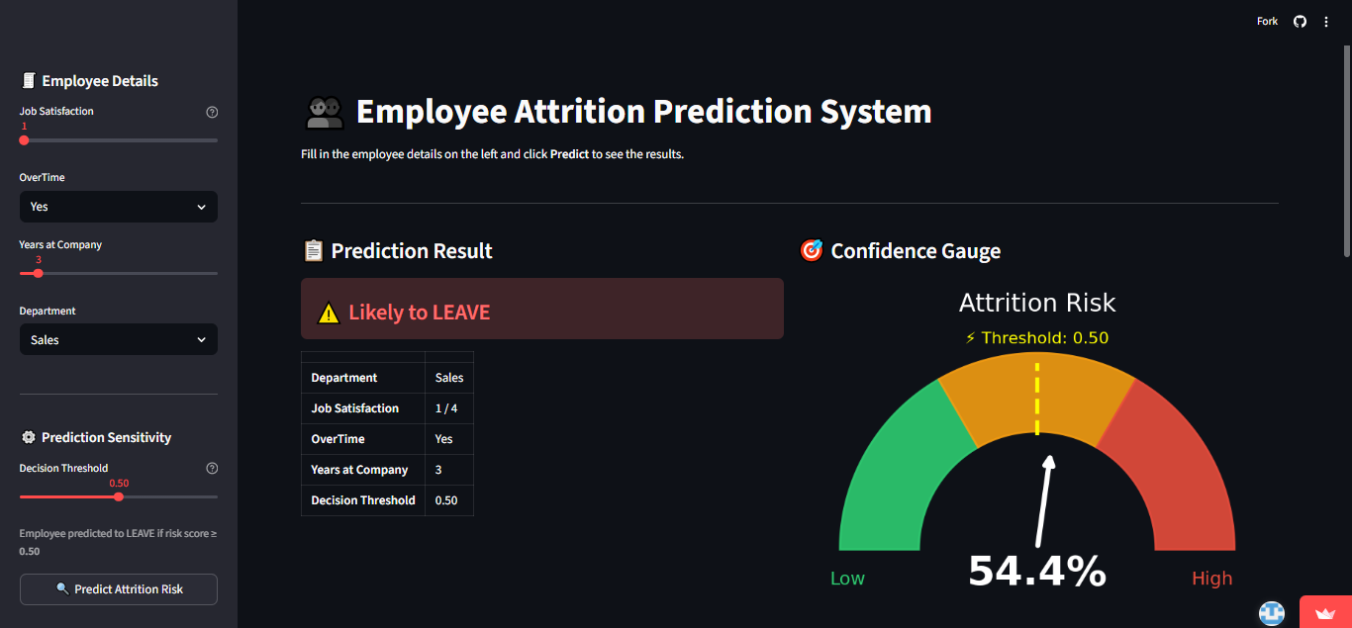
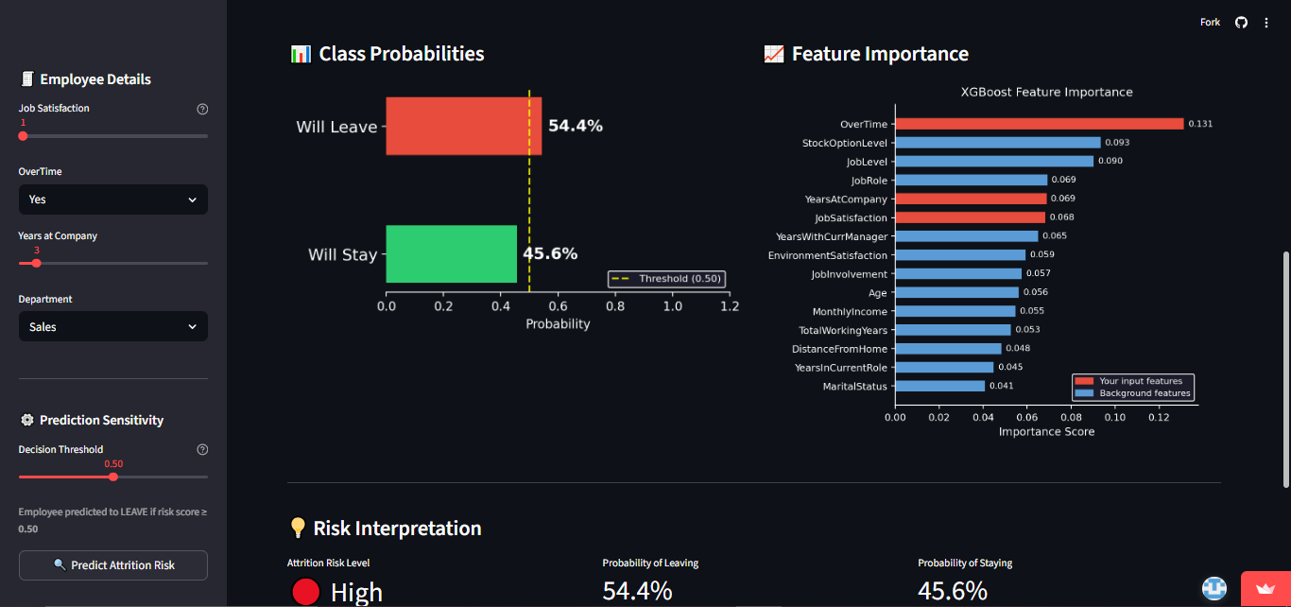

Slide 15
Conclusion & Future Work
Proactive Retention
Machine learning enables HR teams to shift from reactive to proactive employee retention strategies.
High Accuracy
The XGBoost model successfully predicts attrition with ~84% accuracy using interpretable SHAP explanations.
Better Decisions
HR analytics can improve workforce decision-making and significantly reduce organizational loss
⚠️ Limitations
Small dataset size (1,470 records)
Moderate class imbalance (84% / 16%)
Synthetic HR dataset limitations
🚀 Future Work
Real-time HR analytics integration
Employee sentiment analysis
Deep learning implementation
"What-if" financial retention simulations
Explainable AI dashboards for HR teams

